Slide 1
Informed choices, stronger voices: facilitating a world where all adolescents can exercise their SRHR freely
Samiul Islam, Head of Bangladesh Country Advocacy Network (YouthAid)
on behalf of
Nandini Mazumder, Assistant Coordinator
Asia Safe Abortion Partnership (ASAP)
7th Knowledge Fair 2022 organized by Share-Net Bangladesh, 26th September 2022
“Know Better-Be Stronger: Access to Quality Information on SRHR”

Slide 2
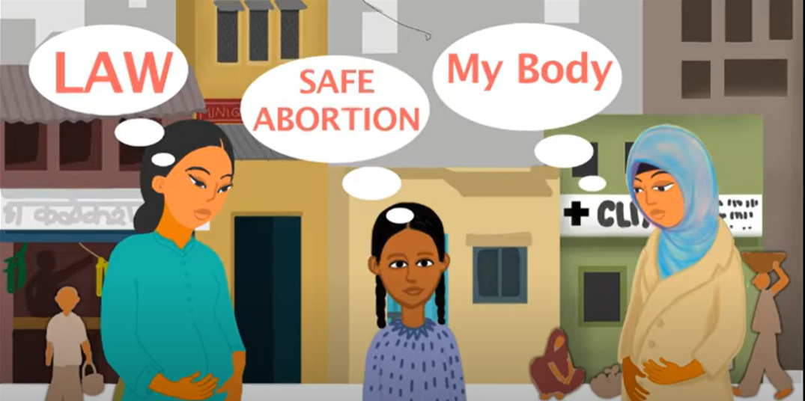
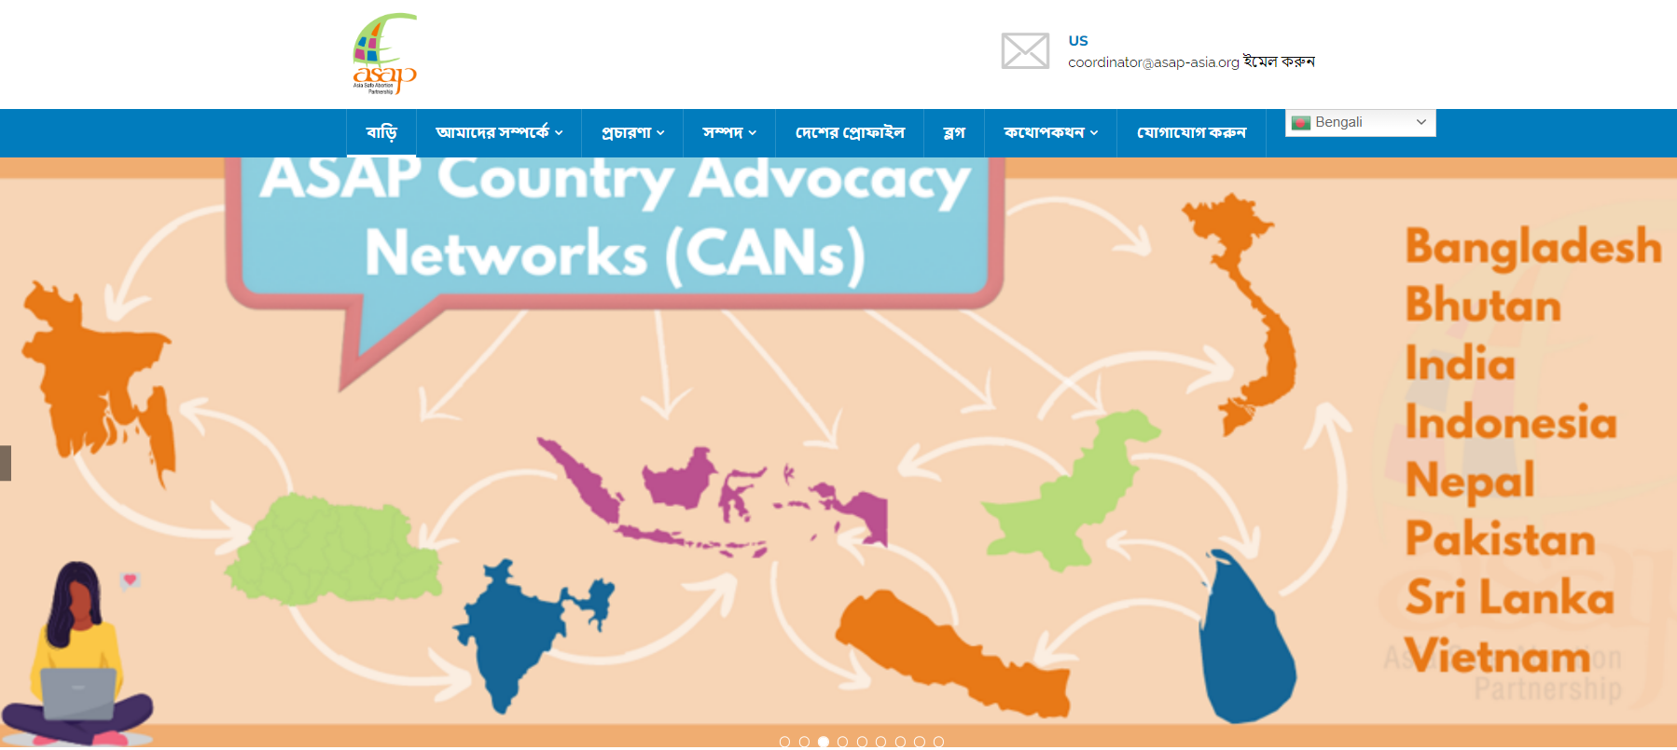
About Asia Safe Abortion Partnership (ASAP)
Founded in 2008
Build a world where no one dies of unsafe abortions
Safe abortion rights advocacy
capacity building
networking with young people and healthcare providers
members in over 23 countries in Asia
Explore our website @asapasia.org and our different social media channels
Youtube, Instagram, Facebook, Twitter and Soundcloud

Slide 3
Unwanted Pregnancies and Adolescents
Reasons for an unwanted pregnancy -
lack of CSE
early, child and forced marriages
rape and incest
issues related to the economy and poverty,
environmental crisis
conflict
ethnic cleansing
wars leading to mass migration
homelessness

Slide 4
Unwanted Pregnancies and Adolescents
WHO defines adolescents as those people between 10 and 19 years of age.
Adolescents are vulnerable
they don’t have information/sex education,
sexuality is stigmatized and even criminalized
sexual activity often begins at a young age with or without consent,
no knowledge of safer sex including how to prevent unwanted pregnancies.

Slide 5
WHO key findings on adolescents and unintended pregnancies
As of 2019, adolescents in (LMICs) had apx. 21 million pregnancies each year, apx. 50% unintended.
Apx. 21 million pregnancies occurred in 2016 among adolescent women in developing regions, where an estimated 12 million resulted in births.
Data on child births among girls aged 10–14 are not widely available.
Based on 2019 data, 55% of unintended pregnancies among adolescent girls end in abortions, which are often unsafe in LMICs.
Adolescent mothers face higher risks of eclampsia, puerperal endometritis and systemic infections than women aged 20–24 years,
Babies of adolescent mothers face higher risks of low birth weight, preterm birth and severe neonatal condition.

Slide 6
The Asian situation
Socio-political and religious factors
Heavy stigma and shame around sexuality
Silencing any conversations around it.
Young people are left on their own to figure it out
Age-based hierarchy in our cultures
Regulations and laws around rape and consent
Inconsistent age of consent – 18 years in Bhutan, India and Nepal, 14 years in Bangladesh, 16 years in Sri Lanka.
Basic understanding that young people are sexual beings and will explore their sexuality.
How can we facilitate a way for them to do so safely, while balancing it with the need to prevent abuse, sexual assaults and forced early and child marriages.

Slide 7
Access to SRHR information and services for Adolescents
The laws on age of consent leading to criminalization of adolescent sexuality
Service providers in many countries are required by the law to report such cases to the police
Child brides are often left out of mainstream programmes and lack decision making capabilities
The question for us working on programmes and policies are therefore:
How do we work with adolescents given the criminalization makes it riskier?
How do we work with child brides and give them information for safer sex and access to SRHR services without shame and stigma?

Slide 8
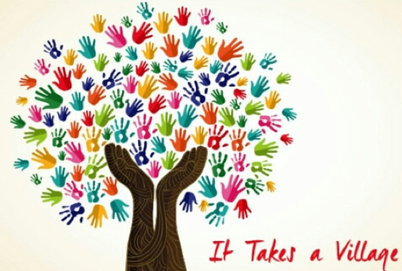
Some strategies that work – building an adolescent friendly enabling environment
Advocating universal CSE in schools
Working with parents, teachers, elder members of the community and going beyond peer to peer approach.
Creating adolescent friendly social, welfare and healthcare systems

Slide 9
Supporting adolescent issues and demanding access to SRHR information and services
Global platforms such as the upcoming ICFP 2022 and so on.
Meaningful Youth Participation
Advocate with donors to support and invest in these critical issues
Strategies that work for adolescents, by adolescents, through adolescents
Notes:
Make sure to elaborate the names and abbreviations when speaking about it.

Slide 10
Conclusion
Nothing about adolescents without them
There is a need to go beyond the peer to peer approach and acknowledge the age-based hierarchical society we live in among other hierarchies
We can support each other by bringing our expertise together

Slide 11
Thank you!

