Slide 1
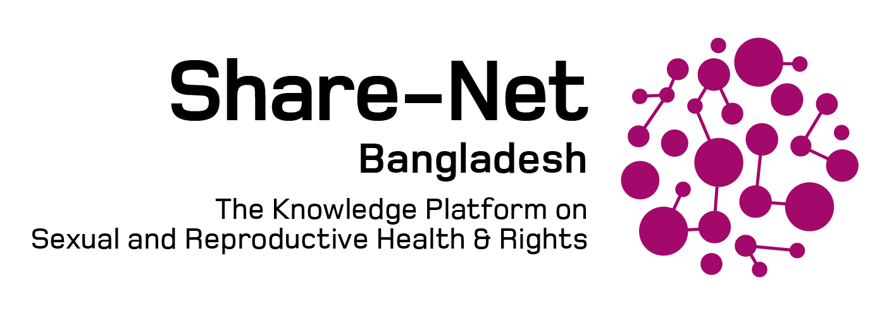
Challenges and opportunities of accessing information on sexual and reproductive health and rights (SRHR) through digital platforms for young people in Bangladesh
Authors: Subas Biswas, Saifa Raz, Syed Hassan Imtiaz, Md. Sajib Rana, Maruf Rahman, Tasfiyah Jalil,
Sabina Faiz Rashid
Date:26 September, 2022
Share-Net Bangladesh Knowledge Fair 2022

Slide 2
Background
Accessing information and services regarding SRHR - a major challenge to the adolescent and young population in Bangladesh
Absence of comprehensive sexuality education
Shame, stigma, taboos, myths and silence around discussions on SRHR issues
Offline activities not always supporting privacy, confidentiality and convenience of accessing information
Lacking information and service negatively impacts their health and wellbeing
Digital platforms have great potential to inform this population about critical and sensitive SRHR related information

Slide 3
Objectives
To explore current practice, attitude and experience in using digital platforms for seeking SRHR related information by adolescents and youth
To identify challenges and opportunities

Slide 4
Methods
Design: A cross-sectional mixed method study
Study population: Male, females and gender diverse population, aged 15-30 years
Data collection period: June-August 2021
(RHRN2 needs assessment and baseline study)
Methods | Study areas | Sites | Number | Participants
Quantitative Survey | 8 upazillas (sub-districts) of 4 districts from 4 divisions | 4 urban and 4 rural | 604 | - Male 45%, Female 46%, and gender diverse (LGBTQI) community people 9% - About half of the respondents belong to 15-20 age group - 80% of respondents have secondary (grade 10) and above education - 30.8% involved in any kind of financial activities
Qualitative Interviews | 4 upazillas of 4 districts from 4 divisions | 2 urban and 2 rural | 33 | 12 IDIs and 4 FGDs with Male, Female and gender diverse (LGBTQI) community people 17 KIIs with parents, community influential persons, gatekeepers, teachers and GO-NGO service providers, RHRN2 coalition partners representatives, SRHR project implementation experts

Slide 5
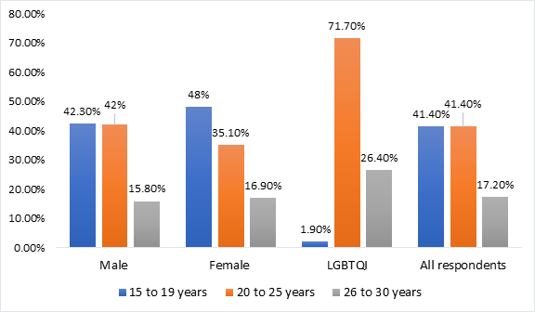
Findings: Accessibility and Utilization of Digital Platforms for SRHR
Among 604 survey respondents, almost 40% reported having access to the internet
Access to the internet
based on age and gender
Use of platforms and content related to SRHR
Among internet based SRHR related information users -
-“YouTube” 42%
- “Google search” 33%
- “Facebook” 27%

Slide 6
"I found information like 'How to seduce a girl' or 'If you have a problem in your genital organ (lingo)' and 'How to stay for a long time.’ There are too many good information on Facebook.”
- 26-year-old unmarried male, Naogaon
Attitude towards
online SRHR information
“We cannot live without the internet. Now, if we get the information when we are online, it is better. Listening to these things in front of everyone is not comfortable. It is better to know alone.”
- 18-year-old unmarried male, student, Rangpur
86% trusted the information online
94% believed that online information improved their SRHR knowledge, and awareness
80% feel comfortable to access SRHR information through online platforms

Slide 7
Challenges
Less access to digital platforms (especially for rural, adolescents, and females)
Weak internet coverage
Inadequate digital literacy
Financial constraints
Inadequate reliable platforms and sources for information and services
Poor quality of SRH information
Weak monitoring over platforms
Social taboos, hierarchical power practices restricts accessing digital platforms
Less investment

Slide 8
Opportunities of ‘Digital platforms’
Emerging as a popular media: accessibility and utilization are increasing
Convenient and monitored information are reliable
Can bypass some social restrictions for seeking information around SRHR
Better option to maintain privacy, anonymity and confidentiality

Slide 9
Concluding remarks
‘Digital platforms for accessing SRHR information’
The young population have considerable demand for accessing SRHR information through digital platforms.
Digital platforms will prove to be an important gateway in providing tailor-made, updated, and verified SRHR information,
by removing the barriers.

Slide 10
THANK YOU
Photo credit: Subas Biswas
Acknowledgement: RHRN2 Bangladesh Coalition Partners, Study participants
Notes:
References
Islam, K.F., Pritom, G.S.M. and Farnaz, N., 2018. A review report on comprehensive sexuality education in Bangladesh. Right Here Right Now and BRAC James P Grant School of Public Health, BRAC University. https://covid-bracjpgsph.org/BRACJPGSPH/assets/pdf/research/research-reports/A%20Review%20Report%20on%20Comprehensive%20Sexuality%20Education%20in%20Bangladesh_July%202018.pdf
Daniels M and Knowledge Facilitator Team. August 2020. Reaching hard-to-reach youth with SRHR messages in Bangladesh. Policy Brief. https://www.nwo.nl/sites/nwo/files/media-files/srhr_-_joint_policy_brief_-_bangladesh.pdf
Camellia, S., Rommes, E. and Jansen, W., 2021. Beyond the talking imperative: The value of silence on sexuality in youth-parent relations in Bangladesh. Global Public Health, 16(5), pp.775-787.
6. Nanda, P. and Tandon, S., 2019. “The Times They Are A-Changin”: using technology for ASRHR in the 25 years since ICPD. Sexual and Reproductive Health Matters, 27(1), pp.349-351. doi: 10.1080/26410397.2019.1676023

