Slide 1
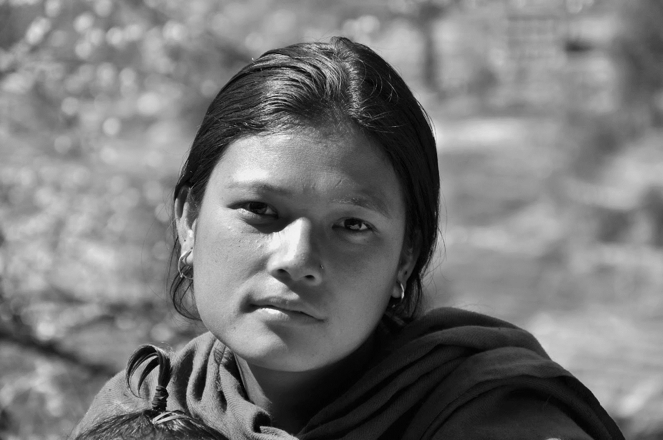
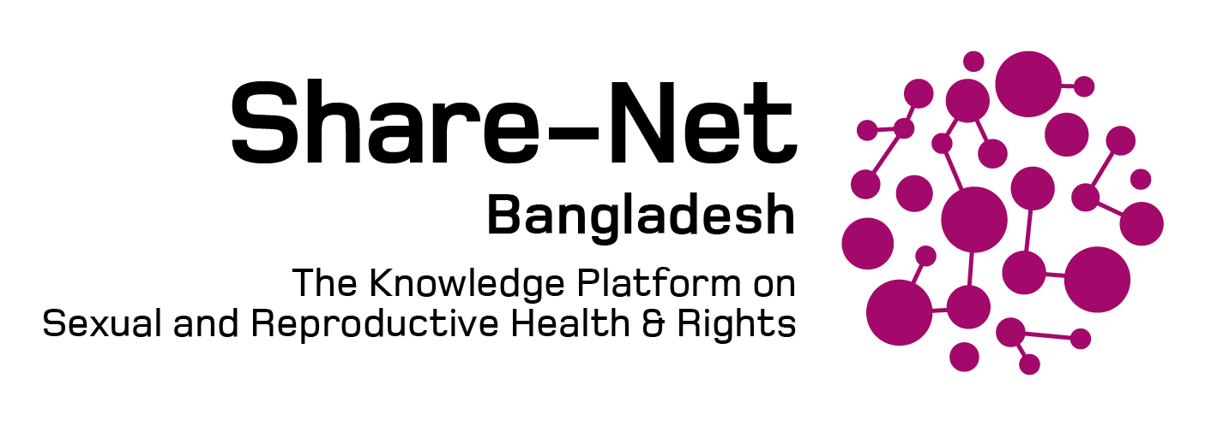
ACCESS TO SRHR (CONTRACEPTION & SAFE ABORTION) INFORMATION AMONG YOUTH, NEPAL
Durga Sapkota

Slide 2
OBJECTIVE
Reflect upon situation of access of quality information on contraception and safe abortion
Analyze the quality of information related to contraception and safe abortion from principle of inclusivity
Exploring possible opportunities to increase access of information around contraception and Safe abortion

Slide 3
SITUATION OF CONTRACEPTIVE USE AMONG ADOLESCENT AND YOUTH
Only 14.5 % of Married Adolescents use modern contraceptives in Nepal. It is about one third of all age group. Unmet Need is 1.5 time high
Adolescent Fertility Rate is high in Nepal

Slide 4
SITUATION OF INFORMATION ACCESS ON CONTRACEPTION AMONG YOUTH
72% of nonusers age 15-19 (married) did not discuss family planning either with peer or health worker or community health worker or at a health facility- ( NDHS, 2016)
Although, the comprehensive sexuality education (CSE) has already been integrated in the curriculum of lower secondary and secondary level in Nepal (optional), a recent study showed notable gaps in delivering the key messages due to insufficient trained teachers for CSE implementation- (Critical Analysis of CSE in Nepal, Yuwa, 2020)
Majority of gynecology practitioners are not trained for the specialized care for LGBTIQ during their residency or thereafter and are thus not comfortable dealing with LGBTIQ population and have judgmental attitude- (Shreyashi, 2022)

Slide 5
SITUATION OF INFORMATION ACCESS ON SAFE ABORTION
Roughly half of pregnancies among adolescents aged 15–19 is unintended (NDHS, 2016).
Overall, 59% women aged 15-49 don’t know that abortion is legal in Nepal. Awareness of the legality of abortion increases with increasing education – NDHS, 2016
52% of women aged 15-49 reported they don’t know a place where a safe abortion can be obtained. – NDHS, 2016
Out of total abortion, 57% of abortion is performed clandestinely. – CREPHA, 2014
22% of the young person living with disability visiting health centre for contraception and safe abortion reported difficulty in communicating with the service providers. (Gaire, 2015)
Friends/Neighbor is the major source of information on Safe abortion and Contraception followed by Radio and Television- (NDHS, 2016 ). Adolescents receive most of the information regarding SRH and contraceptive use from media targeted at the general population also from peers and other informal sources.

Slide 6
Inclusivity & access to quality information on contraception and safe abortion
Information on contraception and safe abortion mostly targeted to married population.
Information on safe abortion and contraception mostly heteronormative.
Person with disability regarded as asexual and hence very minimal disability friendly information available on SRHR

Slide 7
EXPLORING POSSIBLE OPPORTUNITIES
Sexual and Reproductive Health and Rights has been guaranteed as fundamental rights by constitution of Nepal. The provision of information and services should be adolescent and disability-friendly (SMRHR Act 2018)
Incorporate the information around contraception and safe abortion in school curriculum to reduce the incidence of unwanted pregnancy, unsafe abortion and reduce adolescent teenage pregnancy.
Train the health care provider and teachers from right based approach around sex and sexuality
Digital penetration is high so online medium could be effective to increase access to quality information around contraception and safe abortion among youths
Need to implement special approach to reach information to out of school, illiterate, hard to reach areas and person with disability and LGBTI community.

Slide 8
yoshannepal@gmail.com
https://www.facebook.com/yoshanepal
https://twitter.com/yoshanepal
Yo_shan_nepal
https://yoshan.org/

Slide 9
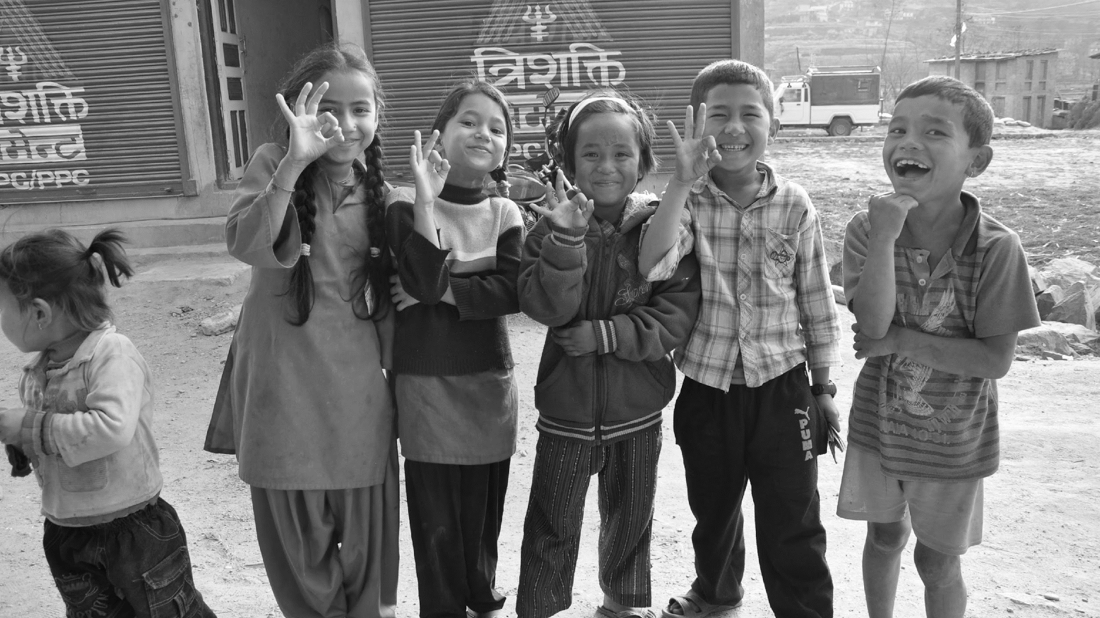
THANK YOU
TWO OBJECTIVES
FOUR QUESTIONS
FINDINGS
TAKE-A-WAYS
QUESTIONS AND ANSWERS

