Slide 1
Observing Like a Health Care Professional: A Qualitative Study into The Access to Information About SRHR among Adolescents in Sylhet City, Bangladesh
Sexual and Reproductive Health and Rights
(SRHR)
Presented by:
Pranto Paul
Student,
Department of Anthropology,
Shahjalal University of Science & Technology, Sylhet
Project Officer, Light to Life

Slide 2
Background
Defining Adolescence
Adolescence is the time between childhood and adulthood (10 and 19 years old) according to World Health Organization (WHO).
Health Care Professionals
Defining
Sexual and Reproductive Health and Rights (SRHR)
Sexual and Reproductive Health services must meet public health and human rights requirements, including the right to health's "availability, accessibility, acceptability, and quality" framework (Lancet and Guttmacher Institute, 2018)
Health professionals maintain health in humans through the application of the principles and procedures of evidence-based medicine and caring (WHO, 2007).
Medical Doctors
Nursing Professionals,
Pharmacists

Slide 3
Background
Global Perspective and SRHR
Sexual and Reproductive Health was recommended at the International Conference on Population and Development (ICPD) in 1995 (Naripokkho, 2017).
Reproductive rights are granted for all people in the ICPD Programme of Action in 1995.
Access information and services concerning SRHR, as well as the liberty to make choices about one's own sexuality and sexual health, are influenced by the assumptions and perceptions held by caregivers and family members (Thurston & Santos, 2022).
SRHR in Bangladesh
SRHR is still a cultural taboo in Bangladesh, especially for adolescents and young people, and particularly outside marriage (Nahar et al. 1999). .
Young people in Bangladesh lack sexual and reproductive health (SRH) information and services, putting them at risk for unintended pregnancy, unsafe abortion, and maternal mortality (Population Reference Bureau [PRB], 2021)

Slide 4
Objective
To find out how health care professionals who work as sources of SRHR information make that information accessible
To reveal the factors that determine the accessibility of SRHR information access among urban adolescents
To know the personal experiences of health care professionals regarding urban adolescents' access to SRHR information

Slide 5
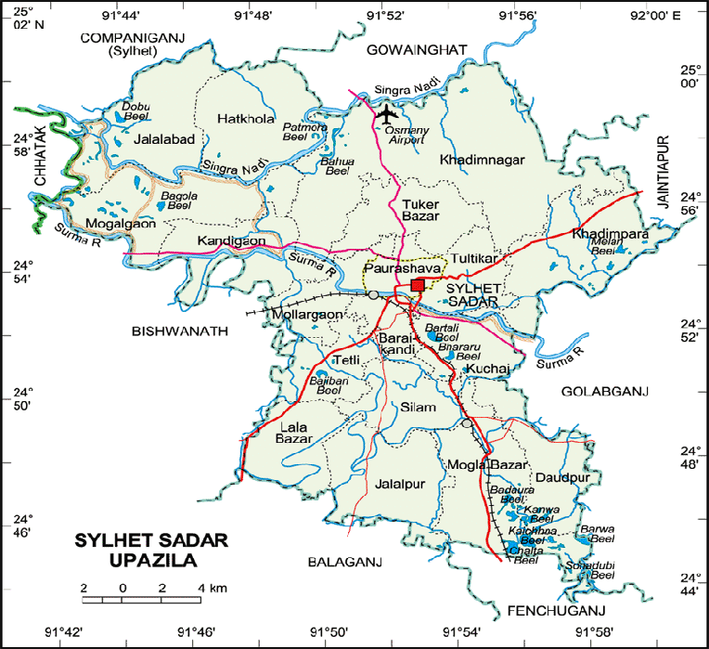
Method
Study type: Qualitative
Study area: Sylhet Sadar, Bangladesh
Sample size: 10 KII
Sampling: Purposive
Data analysis: Thematic Analysis
Ethical Approval: Written consent
Map of the study area

Slide 6
Conceptual Framework of The Study
socioeconomic obstacles, policies, and regulations
Organizational Assistance
Relational Behavior
Culture
Health Care Professionals
Community Engagement
(SRHR Partners)
Positive Indicators
curriculum, culture, religious views
Negative indicators
Human Behavior
Social
Taboo
Community
Lack of knowledge and information
conversations with parents,
peer sexual norms
Common Source of Knowledge

Slide 7
Preliminary findings
Access to SRHR information
Human (inquisitiveness, age, behaviors)
Relational (conversations with parents, peer sexual norms)
Community (curriculum, culture, religious views)
Social (socioeconomic obstacles, policies, and regulations)
Knowledge about SRHR information
Seeking information regarding SRHR
Beliefs, Misconceptions
Social Taboo
school was portrayed as a common source of knowledge
Compared to girls, boys culturally override SRHR information, according to participants
moral ideals of abstinence and virginity

Slide 8
Concluding remarks
Participants from the public and private health sectors recognized the advantages of SRHR education as well as the many channels accessible to younger adolescents for acquiring SRHR information
Identified possible areas for strengthening early adolescents' access to SRHR information in Sylhet, Bangladesh.
SRHR information is beneficial for adolescences

Slide 9
THANK YOU

