Slide 1
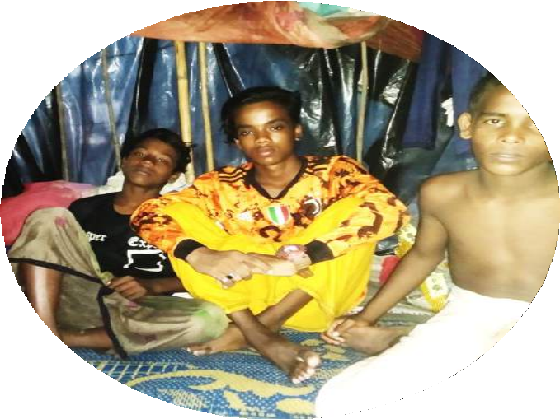

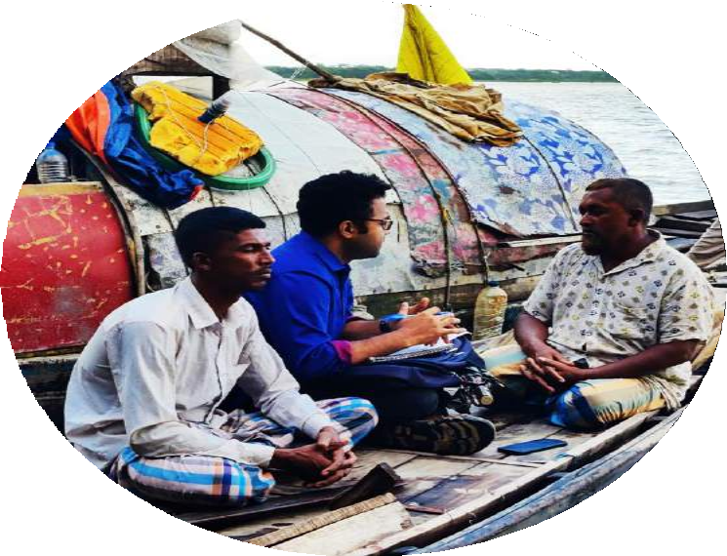
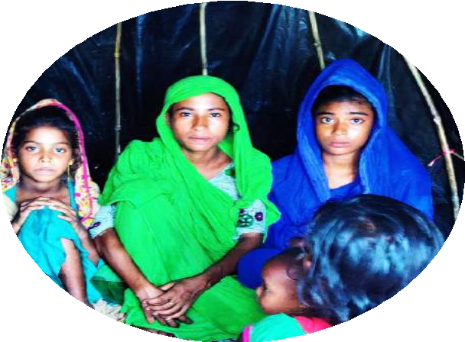
Access to SRHR information for the
Adolescents: The perspectives from grassroot areas from Barisal District of Bangladesh
Presented by
Abdullah Al Zubayer
Young Researcher, Share-Net Bangladesh
www.share-netbangladesh.org

Slide 2
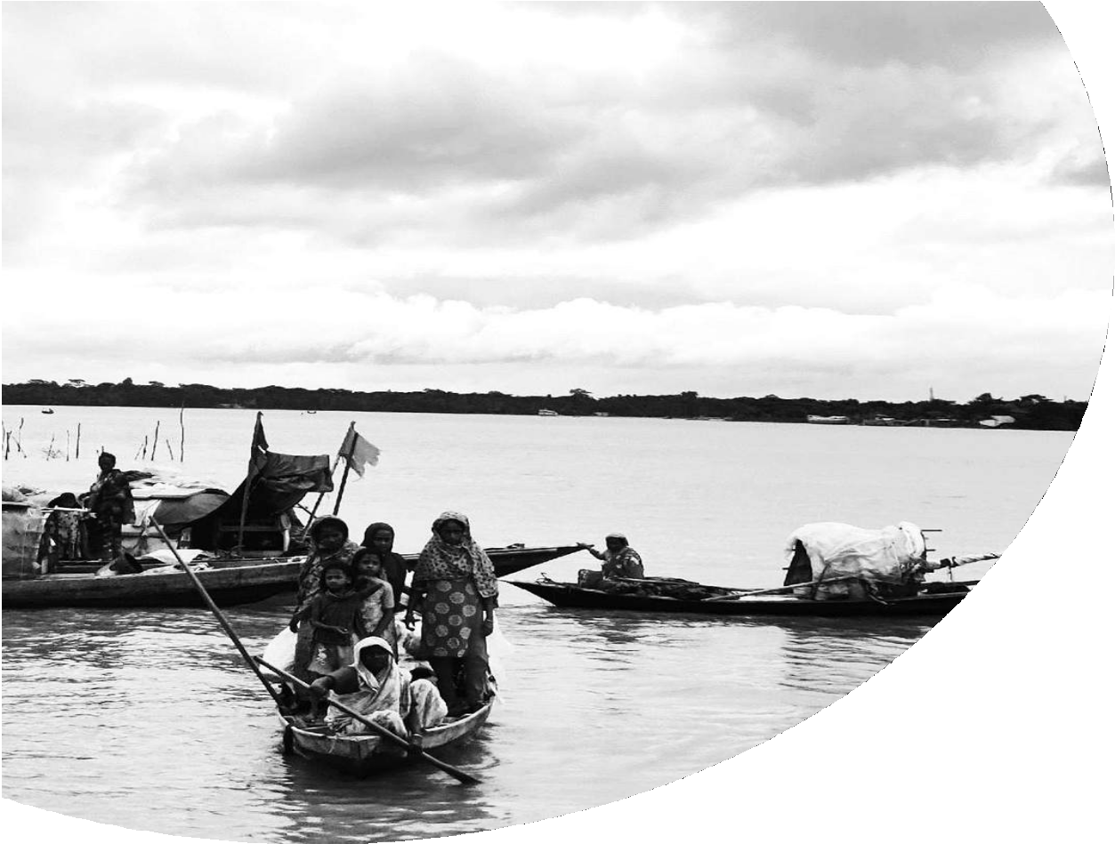

Introduction
CONTENTS
The Grassroot Society of Bangladesh
The SRHR knowledge status of the adolescents
The SRHR knowledge and the adolescents in the grassroots society
Study Design
The study objective and study questions The study hypothesis
The limitation
The study conceptual framework
The study methodological framework, and Study participants
Findings
Finding from FGDs
Finding from KIIs
Discussions
SRHR knowledge transformation process Adequacy and appropriateness
Recommendation and Conclusion
www.share-netbangladesh.org

Slide 3

Introduction
The Grassroot Society of Bangladesh
  Marginally excluded from mainstream society
  Bede, Riverside and Slum dwelling community
The SRHR knowledge status of the adolescents
  Partially known for mainstream communities
The SRHR knowledge and the adolescents in the grassroots society
  Completely unknown for the grassroot communities
  But this “ unknown ” state is acknowledged at the literature
www.share-netbangladesh.org

Slide 4
Study Design
Objective and Questions
  How is SRHR knowledge transferred to adolescents in the grassroots?
  How much adequate and appropriate knowledge is received by those adolescents?
  What should be the programmatic interventions for reaching them with adequate and appropriate SRHR knowledge?
Hypothesis
  The process of how that SRHR information gets transferred is not fair
  SRHR knowledge, as transferred to those adolescents, is not adequate or appropriate
  The appropriate programmatic intervention can change the current scenario that has
inadequate and inappropriate SRHR information
Limitation
  Cannot comment on how many adolescents know and how much they know
  Cannot be used as the baseline study for any intervention, but it can be used as evidence
www.share-netbangladesh.org

Slide 5
Conceptual Framework and methodological Framework
SRHR Info Flow
Inappropriate and Inadequate Knowledge
Mal Practice
Existing Scenario
Programmatic Intervention
SRHR Info Flow
Appropriate and Adequate Knowledge
Not Mal Practice
Desired Scenario
Qualitative Study with Thematic Analysis
FGDs with adolescents (15)
KIIs with teachers, NGO workers, local govt. representatives, community leaders, pharmacists (15)
www.share-netbangladesh.org

Slide 6
Findings (Adolescents)
Issue | Early Adolescents |  |  | Late Adolescents
 | Bede | Riverside | Slum | Bede | Riverside | Slum
Body Change | Acknowledged | Acknowledged | Acknowledged | Acknowledged | Acknowledged | Acknowledged
Sex Education | No | No | No | No | No | No
STDs | No clear concept | No clear concept | No clear concept | No clear concept | No clear concept | No clear concept
Family planning | No clear concept | No clear concept | No clear concept | No clear concept | No clear concept | No clear concept
Talk to the family members | Both boys and girls | Only girls for menstruation | Only girls for menstruation | Both boys and girls | Only girls for menstruation | Only girls for menstruation
Shyness | Yes | Yes | Yes | Yes | Yes | Yes
Sources of the information (Boys) | Not clear | Not clear | Not clear | Friends and pornography | Friends and pornography | Friends and pornography
Sources of the Information (Girls) | Not clear | Not clear | Not clear | Female family members and romantic movies | Female family members and romantic movies | Female family members and romantic movies
www.share-netinternational.org

Slide 7

Findings (FGDs)
Acknowledged about body changes
No sex education
Incomplete ideas about Sexually Transmitted diseases (STDs)
No complete idea about family planning
Always getting Shy to talk about those issues
Only girls can talk to their parents, but limited to
menstruation
Serious knowledge gap
www.share-netbangladesh.org

Slide 8
Findings (KIIs)
Informed about the situation (partially)
But doing nothing
They have more serious issues, like poverty, land management crisis, and social resource allocation, health and WASH and more others to work for as they perceive
www.share-netbangladesh.org

Slide 9
Discussions
FGDs with the adolescents
SRHR knowledge transformation process
Early adolescents don’t have any sources of information
Late adolescent boys are getting information from friends and Pornography
Late adolescent girls are getting information from female family members
and romantic movies
Only girls can talk to their parents, but limited to menstruation and boys are always excluded from sharing information with family members
Adequacy and appropriateness
  Neither adequate, nor appropriate
www.share-netbangladesh.org

Slide 10
Conclusions and Recommendations
Despite some socio-economic anomalies among those three communities, the adolescents of these communities have both inadequate and inappropriate
information on SRHR.
The relevant stakeholders are informed but they are doing nothing as they
perceive other issues require more concentration
We need specific SRHR interventions with a holistic approach. We need to acknowledge that the partially concentrated programs and the programs excluding the boys, alone cannot resolve this issue completely
Current development issues like poverty, land management or resource distribution
+
=
Holistic
Intervention
SRHR knowledge intervention (E.g. Mina Cartoon, SRHR training, Teacher’s capacity building)
Integrating into existing programming that focus on WASH, women empowerment, etc. by including SRHR into those and making sure to include boys
www.share-netbangladesh.org

Slide 11
THANK
FOR LISTENING!
“Pornography contains everything, We can understand every single thing through watching porn video”
(late adolescent boy, Slum Community, 15)

Slide 12
THANK YOU
FOR LISTENING!
“SRHR Knowledge product contains everything, We can understand every single thing through watching SRHR related informative video”

