Slide 1

Gender Based Violence (GBV) among the Internal Mandi (Garo) Migrants in Dhaka City: A Qualitative Study
DR. ZOBAIDA NASREEN
PROFESSOR, DEPARTMENT OF ANTHROPOLOGY
UNIVERSITY OF DHAKA.
ZOBAIDANASREEN@GMAIL.COM
RESEARCH ASSOCIATE: MUNNI MREE

Slide 2
Objectives of the Research
1. To explore the perception of Gender based violence (hereafter GBV) among the Mandi women.
2. To find out the main sources of GBV related information and their utilities among the Mandi women.
3. To find suitable ways to make the information easily accessible for the Mandi women.

Slide 3
Methodology
The approach of the study is multi-sited and discursive, grounded in a qualitative methodology.
Sources of data
Secondary data
Primary Data
  In-Depth Interviews (IDIs) (20)
  Focus Group Discussions (FGDs) ( 03)
Research Ethics

Slide 4
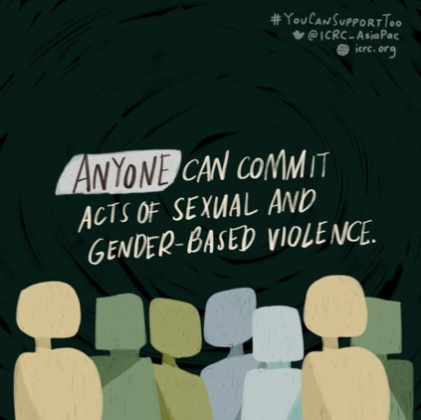
PERCEPTIONS OF GBV
Types of Violence | Number | Percentage
Racist and sexist comment | 7 | 16.277
Physical torture | 3 | 6.97
Salary cut | 3 | 6.97
Sexual abuse | 3 | 6.97
Threatening | 4 | 9.30
Abusive language | 6 | 13.95
Double workload | 2 | 4.65
Forcefully locked up | 4 | 9.30
Hold back wage payment | 3 | 6.97
Misbehavior | 4 | 9.30
Multiple | 4 | 9.30
Total | 43 | 100

Slide 5
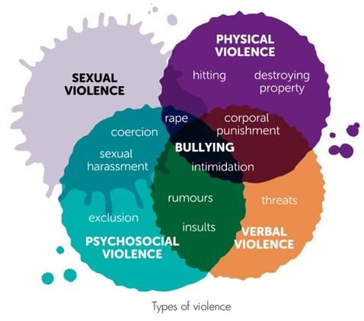
Types of Violence
14% of Mandi women in this study reported experiencing physical violence.
44% of the total respondents of this study have experienced sexual harassment at some point in time.
51% of the total respondents said they have been victims of emotional abuse at various times. About 23% said they faced unpleasant comments because of their ethnic identity, appearance and religious identity.
In most of the establishments where the respondents work, no appointment letter has been issued. Due to which they cannot realize the rights of the workers, rather they are subjected to harassment.

Slide 6

Sources of GBV Related Information and Their Utilities Among Mandi Women
Sources of Information
  Television, ILo workshop, SAFE
Justice seeking behavior
  Rarely seek remedy
  Remain silent
  Usually do not go for court cases
Barriers
  Financial & social vulnerability
  Time constraint
  Limited source of information
  High chances to not get justice
  Corruption/illegal practice of indigenous leaders

Slide 7

Suitable ways to make the information easily accessible for the mandi women
1. Make available to the Mandi women a list of organizations that offer free legal services.
2. All information should be translated into Mandi language and are readily available to the Mandi women.
3. Where there is a large population of Mandi communitarians (e.g. Kalachandpur), government and non government organizations provide information on gender-based violence and its countermeasures in various schools, colleges and churches.

Slide 8

Suitable ways to make the information easily accessible for the mandi women
4. It is also important to promote the government's free legal services and know where to get those services.
5. Non-Governmental Organizations can adopt projects like SAFE, through which gender-based violence and its subsequent criminal relations can be learned through discussion and increase their confidence.
6. National and international organizations on gender-based violence should undertake more programs and ensure the inclusion of indigenous women.

Slide 9
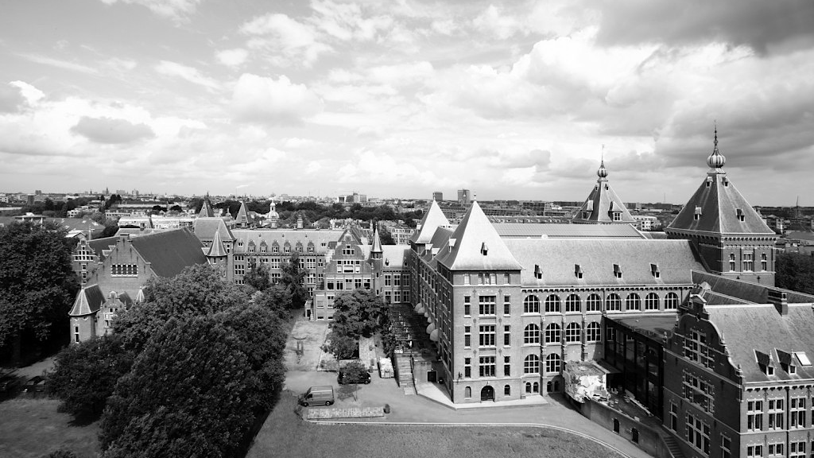
THANK YOU
FOR WATCHING

